Slide 1

ANDRIVE
Group Project Proposal
Dennise, Mandrix, Killian & Yan Jun
Created by
Mangroup Cooperation

Slide 2
Table of Contents
01
02
04
05
Problem Statement
Background
03
Business Objectives
Games Overview
Project Planning
06
References

Slide 3
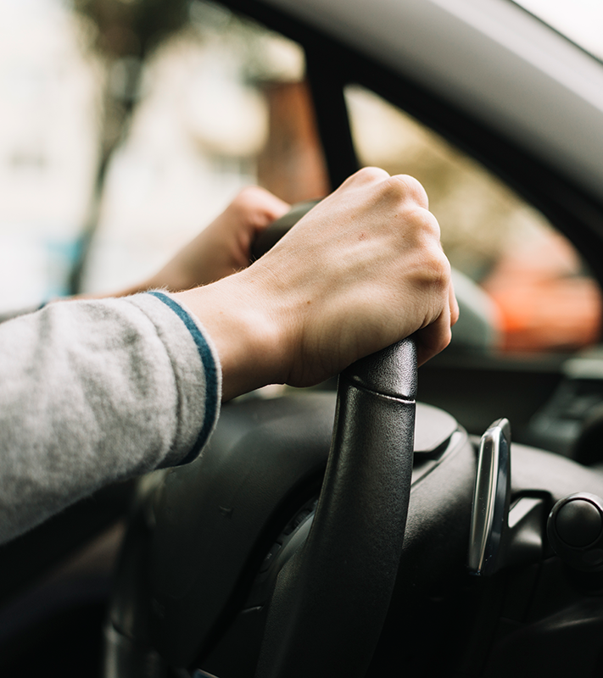
01
Problem Statement

Slide 4
Problem Statement
“The other ride-hailing apps are boring and do not offer much when it comes to the users, it would focus more on profit rather than user experience and engagement.”

Slide 5
02
Background

Slide 6
Local testimonies
“There's inconsistency with cancellations, creating a confusing and inconvenient experience.” ~ BusyTrain (Google Play Review)
“Very unintuitive interface” ~ George Z (Google Play Review)
“The app feels quite confusing to use when I first started.” ~ Dennise’s parents
“The app is quite empty with nothing exciting to see.” ~ Mandrix’s parents

Slide 7
ANDRIPS
A clothing company founded since the 1500s.
A company we created in Semester 1

Slide 8
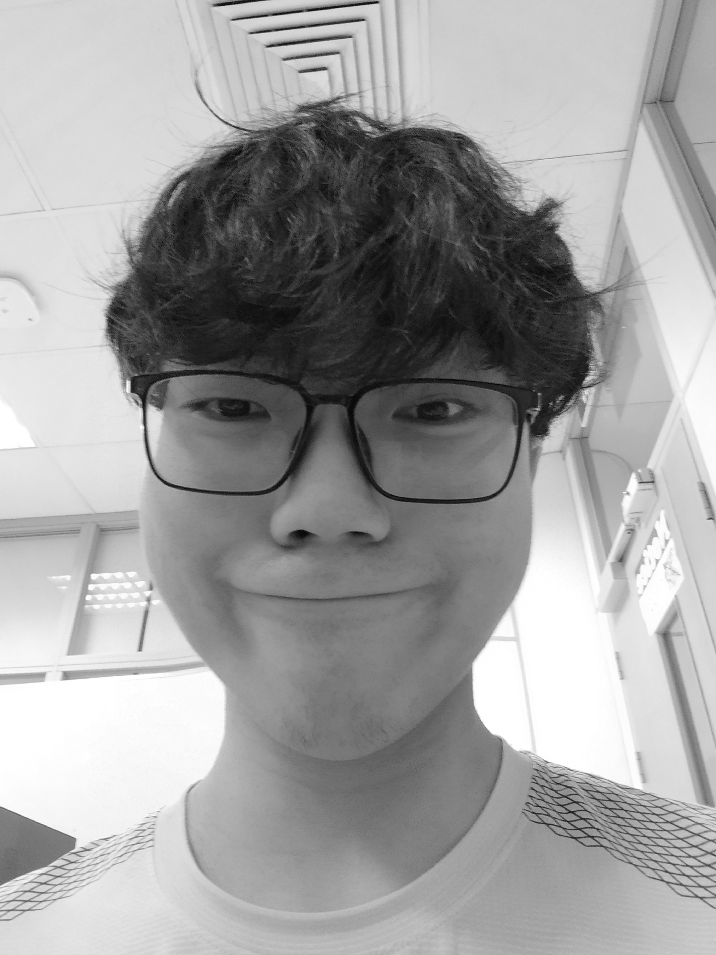
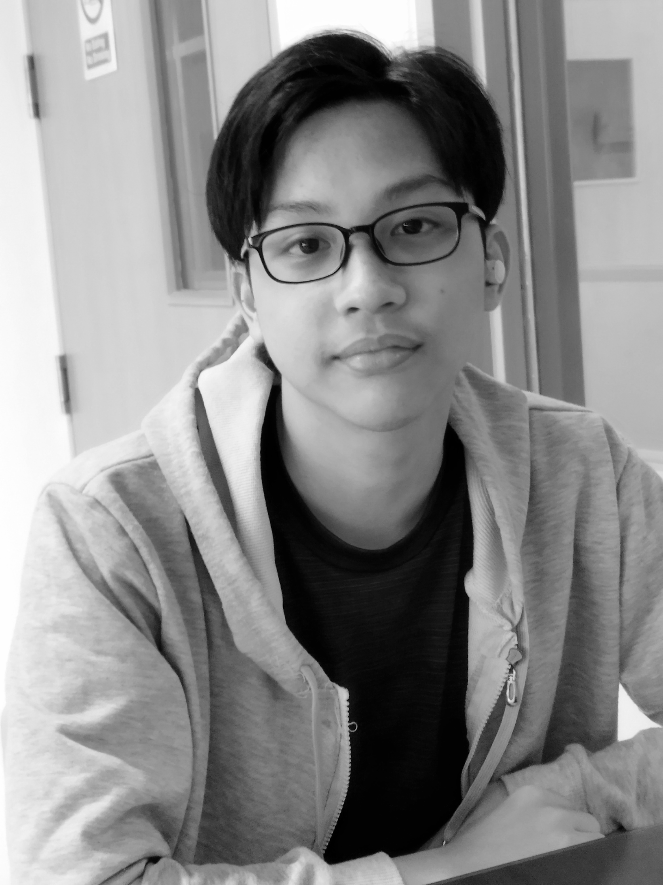
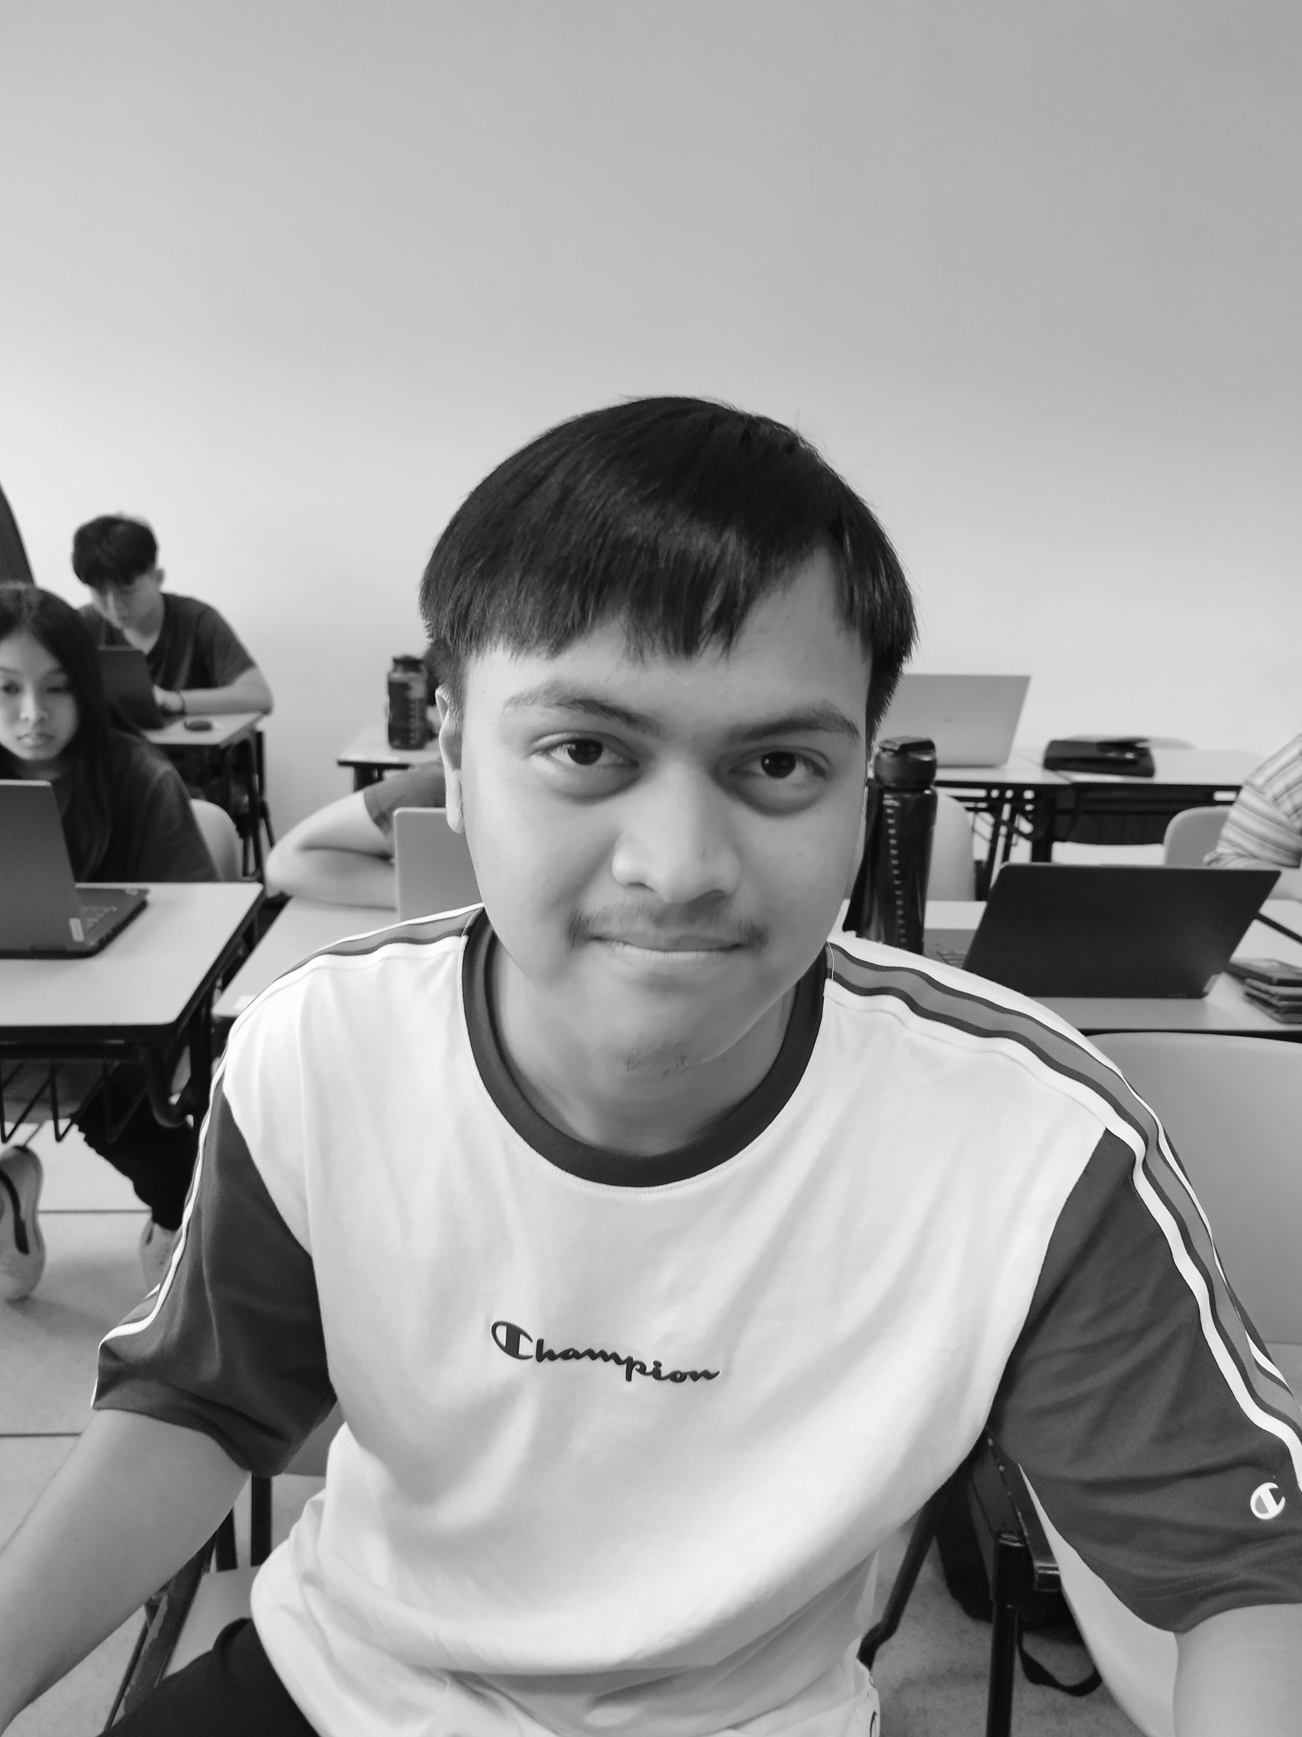
OUR PREVIOUS CEOs
Cillian the Rizzler 3rd Generation CEO
1632 - 1712
Denis the Extraordinaire 7th Generation CEO
1838 - 1912
Mandrips the Great
Founder
1496 - 1581

Slide 9
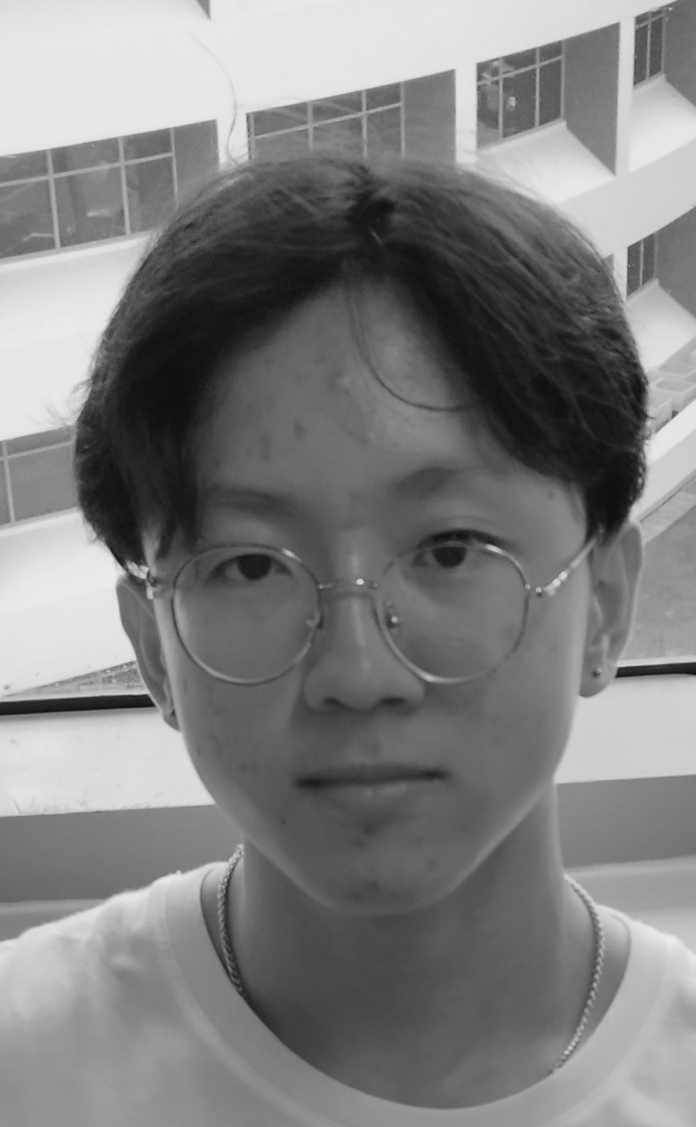
Our vision is to expand
the Mandrips brand
to a well-known industry. Transportation is used
by many in Singapore
by starting a transport
subsidiary, we can
easily spread our
influence and open our
brand to others.
Brandon the Tremendous Current CEO 1956 - Now

Slide 10
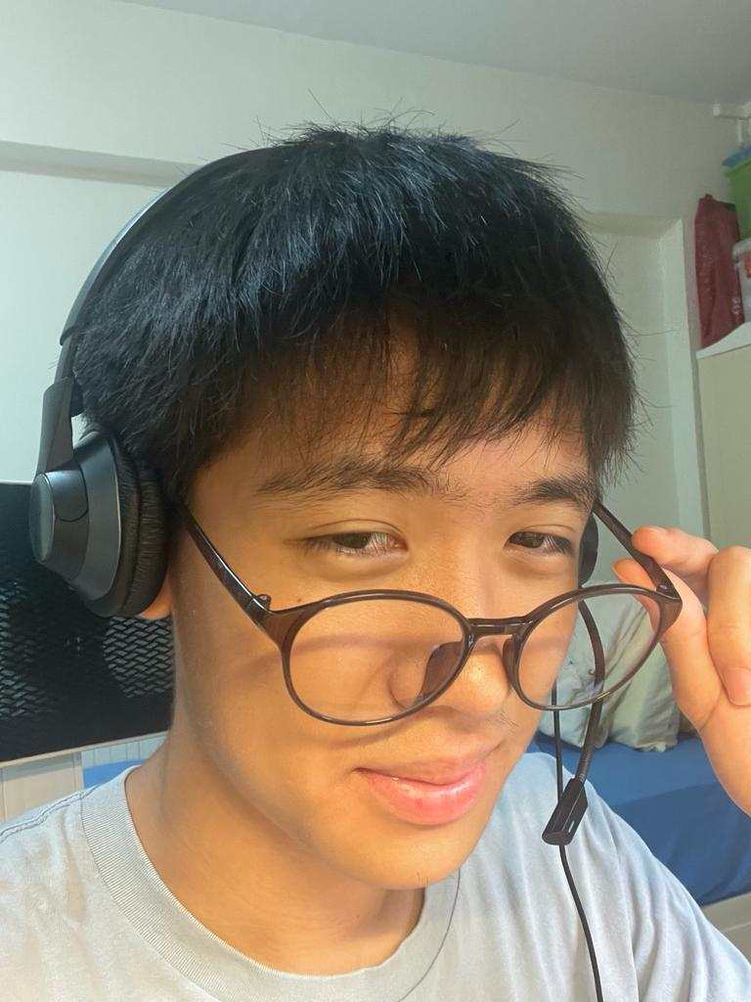
Our vision is to expand
the Mandrips brand
to a well-known industry. Transportation is used
by many in Singapore
by starting a transport
subsidiary, we can
easily spread our
influence and open our
brand to others.
Jun Yan the Spectrum Head of Innovation 2001 - Now

Slide 11



Background
A ride-hailing app that enables users to easily book rides, tracks drivers, and make seamless in-app payments, offering a convenient transportation solution for the city. Our app also comes along with in-app games that allows users to earn rewards and deals.
Mandrive

Slide 12
03
Business Objectives

Slide 13
Business Objectives
Convenience & Accessibility
Entertaining Customers
Enhanced User Experience
Our app is accessible on multiple platforms like PC and mobile. While being user friendly and easy to use.
Customers can entertain themselves while waiting for a ride by playing a game in our app.
Having an appealing design and a simple interface allows the user to easily navigate and enjoy our services.

Slide 14
Business Objectives
Attract customers with rewards
Improve Traction to Mandrips
A reward system entices the customers with a reward for using our services.
Being under the Mangroup, Mandrive is used to promote Mandrips which brings traction to it.

Slide 15
04
Games Overview

Slide 16
Derby Denis
In this racing game, use WASD keys to control a race car
Finish 3 laps on the racetrack before time runs out
Stay on the track at all times

Slide 17
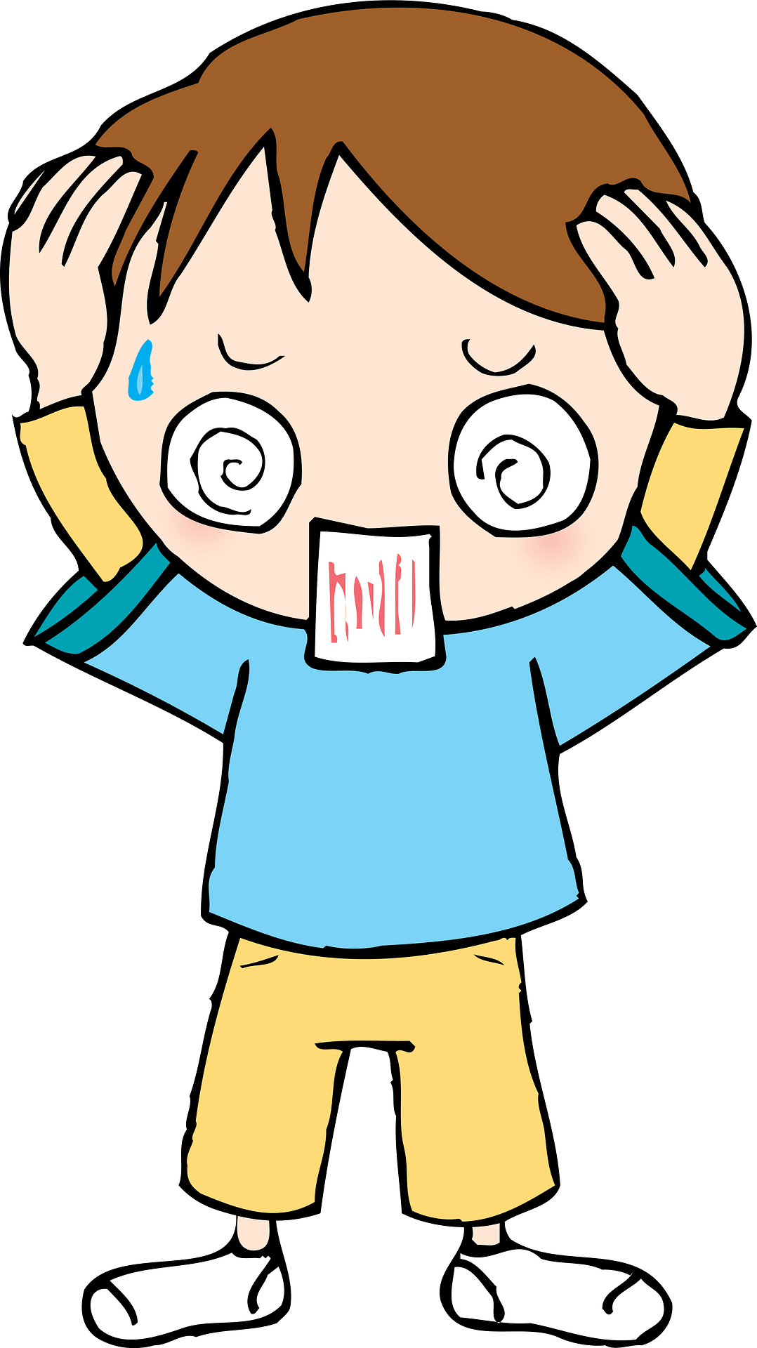

Dripless Brandon
Brandon the Tremendous needs his drip!
Pick the right clothes from the Mandrips store before the timer runs out!
If you fail to collect all the required clothing, his girlfriend will run away!

Slide 18

Cillian’s Quest
Help free Cillian so he can rescue his damsel in distress!
Players will have to help Cillian navigate the dungeon’s maze layout
This puzzle-maze game will keep players engaged while they wait for their ride to end

Slide 19
05
Project Planning

Slide 20
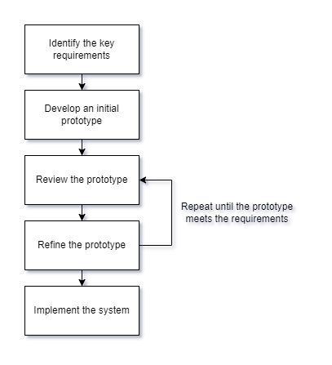
Prototyping Approach
Emphasis on user interface (UI) and user experience (UX).
There are lots of testing needed. So many refinements can be made.

Slide 21
Week | Task | Assignee(s) | Start Date | End Date | Duration
9 | Design user interface | Dennise, Yan Jun | 2023-12-11 | 2023-12-18 | 1 week
9 | Design respective game specifications | Dennise, Mandrix, Killian | 2023-12-11 | 2023-12-18 | 1 week
10 | Build initial user interface | Killian, Yan Jun | 2023-12-18 | 2024-01-08 | 3 weeks
10 | Build initial prototype for respective games | Dennise, Mandrix, Killian | 2023-12-18 | 2024-01-08 | 3 weeks
13 | Check-in/Quality check review | All team members | 2024-01-08 | 2024-01-15 | 1 week
14 | Refine prototype (e.g. user interface, games, functions) | Dennise, Killian | 2024-01-15 | 2024-01-22 | 1 week
15 | Check-in/Quality check review | All team members | 2024-01-22 | 2024-01-29 | 1 week
15 | Prepare for final presentation | Yan Jun, Mandrix | 2024-01-22 | 2024-02-05 | 2 weeks
16 | Refine prototype (e.g. user interface, games, functions) | Dennise, Killian | 2024-01-29 | 2024-02-05 | 1 week
17 | Final presentation | All team members | 2024-02-05 | 2024-02-08 | 4 days

Slide 22
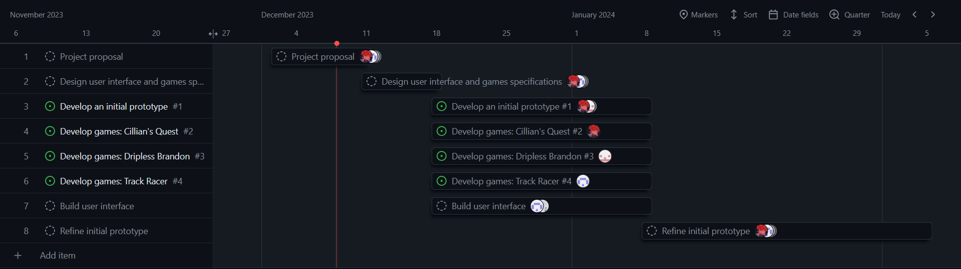

Slide 23
06
References

Slide 24
References
Mandrips
Grab App @ Google Play Store
Local testimonies

Slide 25
Thank you!
Do you have any questions?

